Slide 1


The banking
System
Presented by-
Kaustubh R Srivastav
Krati Srivastav
Kuldeep Singh
Under Prof. Deepti Singh

Slide 2


Programming & Scripting Languages used:
JavaScript
WampServer (MySQL for Database)

Slide 3


Tools to be used
NetBeans IDE
NetBeans is an integrated development environment (IDE) for Java.
NetBeans allows applications to be developed from a set of modular software components called modules. We will use inbuilt Java Web Application
WampServer MySQL Database
MySQL is an open-source relational database management system. With PHP, you can connect to and manipulate databases.
MySQL is the most popular database system used with PHP.

Slide 4
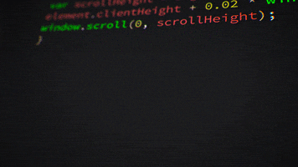
Features of our project
Lets head to the outline project to give a better understanding.
Our project is capable of preforming following tasks:-
Account Creation
Connectivity to Bank Database
Profile Management for each Customer
Deposit and Transfer of Money
Transfer of Money to another bank account
Cash Withdrawal
Maintaining Transaction History
Pin Change and Balance Enquiry

Slide 5

That’s all Folks!!!

